Slide 1



An Introduction to HTML5 & CSS3
Week 19 – Semester 2

Slide 2
What is HTML5 and css?
The definition given by w3schools is…
“HTML is the standard markup language for creating Web pages”
HTML stands for Hyper Text Markup Language
HTML describes the structure of Web pages using markup
HTML elements are the building blocks of HTML pages
HTML elements are represented by tags
HTML tags label pieces of content such as "heading", "paragraph", "table", and so on
Browsers do not display the HTML tags, but use them to render the content of the page

Slide 3
What is HTML5 and css?
The definition given by w3schools is…
“CSS is used to define styles for your web pages, including the design, layout and variations in display for different devices and screen sizes”
CSS stands for Cascading Style Sheets
CSS describes how HTML elements are to be displayed on screen, paper, or in other media
CSS saves a lot of work. It can control the layout of multiple web pages all at once
External stylesheets are stored in CSS files

Slide 4
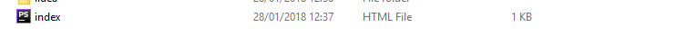
Creating a HTML Document
Open your text editor of choice – for this example I shall be using phpstorm…
Make sure you name your page index.html – this is important as unless specified the server will look for index.html by default

Slide 5
Creating a HTML DOCUMENT
3) In the index file you need to write the basic markup of HMTL. For that we need the following…
DOCTYpe
lang
Head
Meta
Title
Body

Slide 6
What does any of that mean…
DOCTYPE – This is the very first thing that is declared in html. It is not a conventional html tag, instead it is used to instruct the webpage on what version of html is being used…
<!doctype html> = this is an indication to use HTML5 – the version we shall use
Unlike most tags in html DOCTYPE does not have a closing tag.

Slide 7
What does any of that mean…
Lang – it is used to specify the language used in the elements content
<html lang=“en”> = this says that the html tag, as specified previously, is written in English. You would use specifications such as “es” for Spanish and “fn” for French

Slide 8
What does any of that mean…
HEAD – This is a place where meta data (Data about data) goes. It is placed between the HTML and BODY tags. It is used to contain the following tags…
<title>
<style>
<meta>
<link>
<script>
<base>
<head> = this is the declaration for head – very simple ☺

Slide 9
What does any of that mean…
Meta – is used to state which character set is being used. This can include author, description as well as keywords etc.
<meta charset = “utf-8”> = we are declaring that we shall encode characters in utf-8. This is the most common way of encoding in email and webpages.

Slide 10
What does any of that mean…
Title – This tag defines the title of the document. This also applies when it is in the toolbar and favourites of the browser as well as the name that appears when in a search engine
<title> = this is the declaration for title – even more simple ☺

Slide 11
What does any of that mean…
Body – This is used to define the body of the document. This is used to contain the contents of the page for example, text, hyperlinks, images, tables, lists, etc.
<body> = super simple ☺

Slide 12
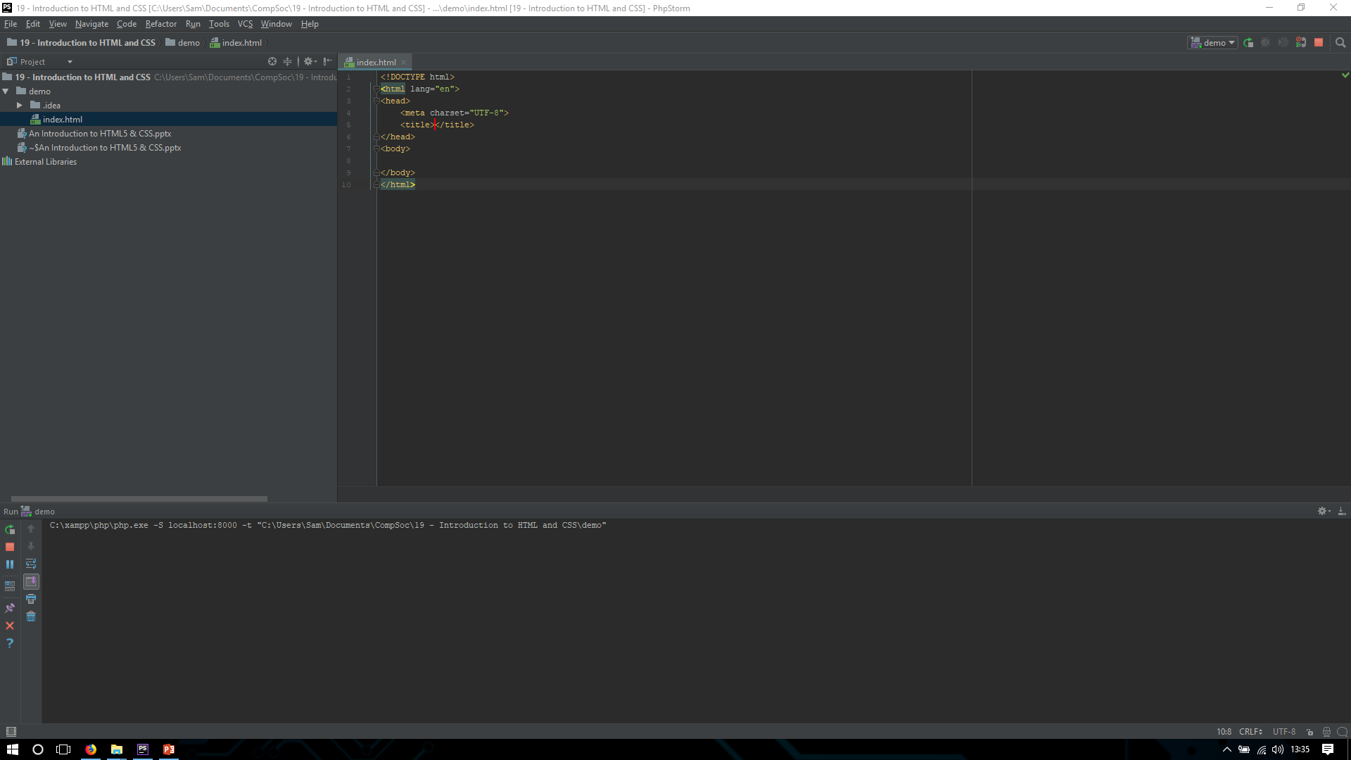
Back to the website
I hope you remembered all that. Cause we now need to put it into the document…

Slide 13



CODE
Site

Slide 14
Lets add some content
Lets make a title for the webpage. To do this enter the title between the two title tags.
How about we add some information to the page. To do this we must use the paragraph tag.
Paragraph – This is used to add text to our page
<p> = this is easy
REMEMBER HOWEVER, THE P TAG MUST GO IN BETWEEN THE BODY TAGS…

Slide 15
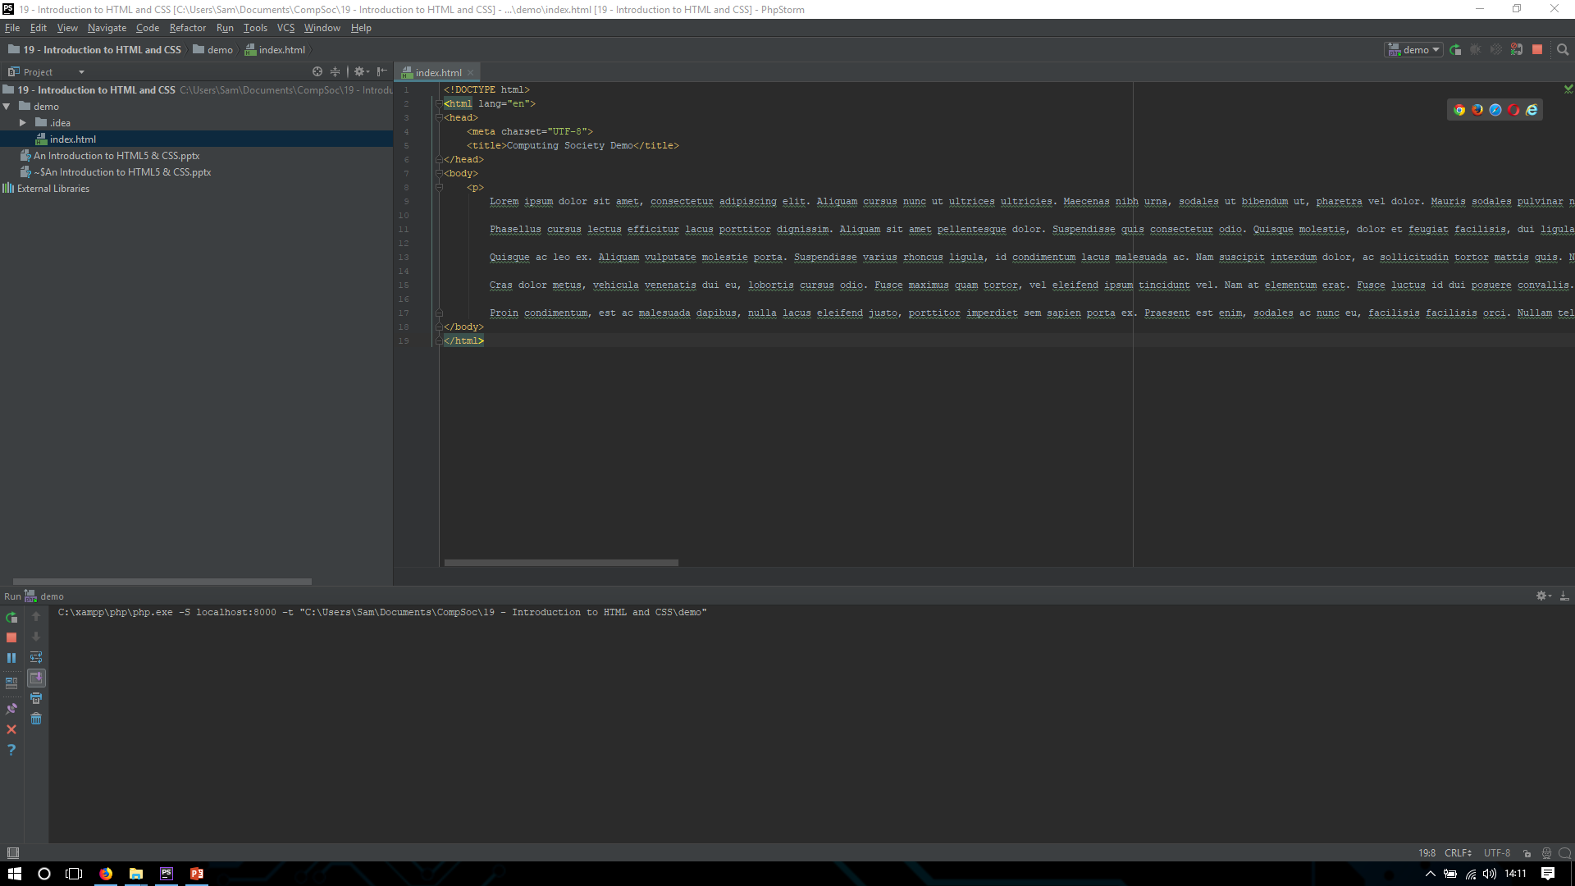
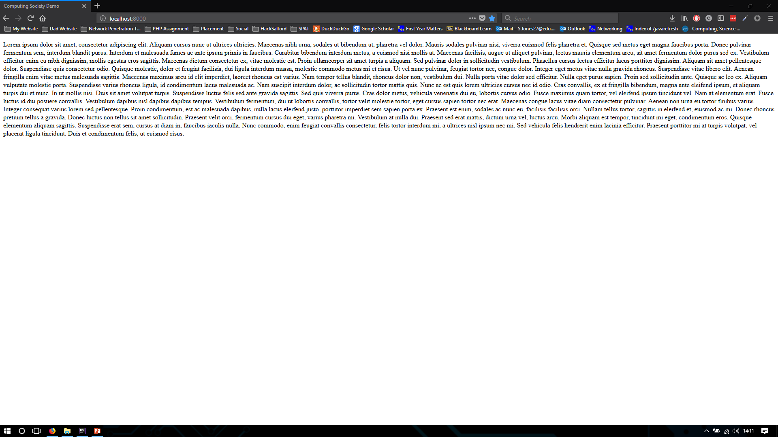
CODE
Site

Slide 16
Lets add some content
HOW ABOUT SOME IMAGES ON OUR WEBPAGE? IF WE WANT TO DO THIS WE NEED TO USE THE IMAGE TAG…
<img src=“directory link to image” alt=“description” height=“50” width=“50”/> = this is a little more complex
Src = This is the source for the image located in your computer e.g src=“C:/users/Sam/pictures/demo.jpg”
Alt = This is the text that will appear should the image be missing or not located on the computer
Height = This is the height of the image in pixels
Width = This is the width of the image in pixels
MAKE NOTE THAT IN HTML THE IMG TAG IS SELF CLOSING – HENCE THE / AT THE END OF THE DECLARATION.

Slide 17
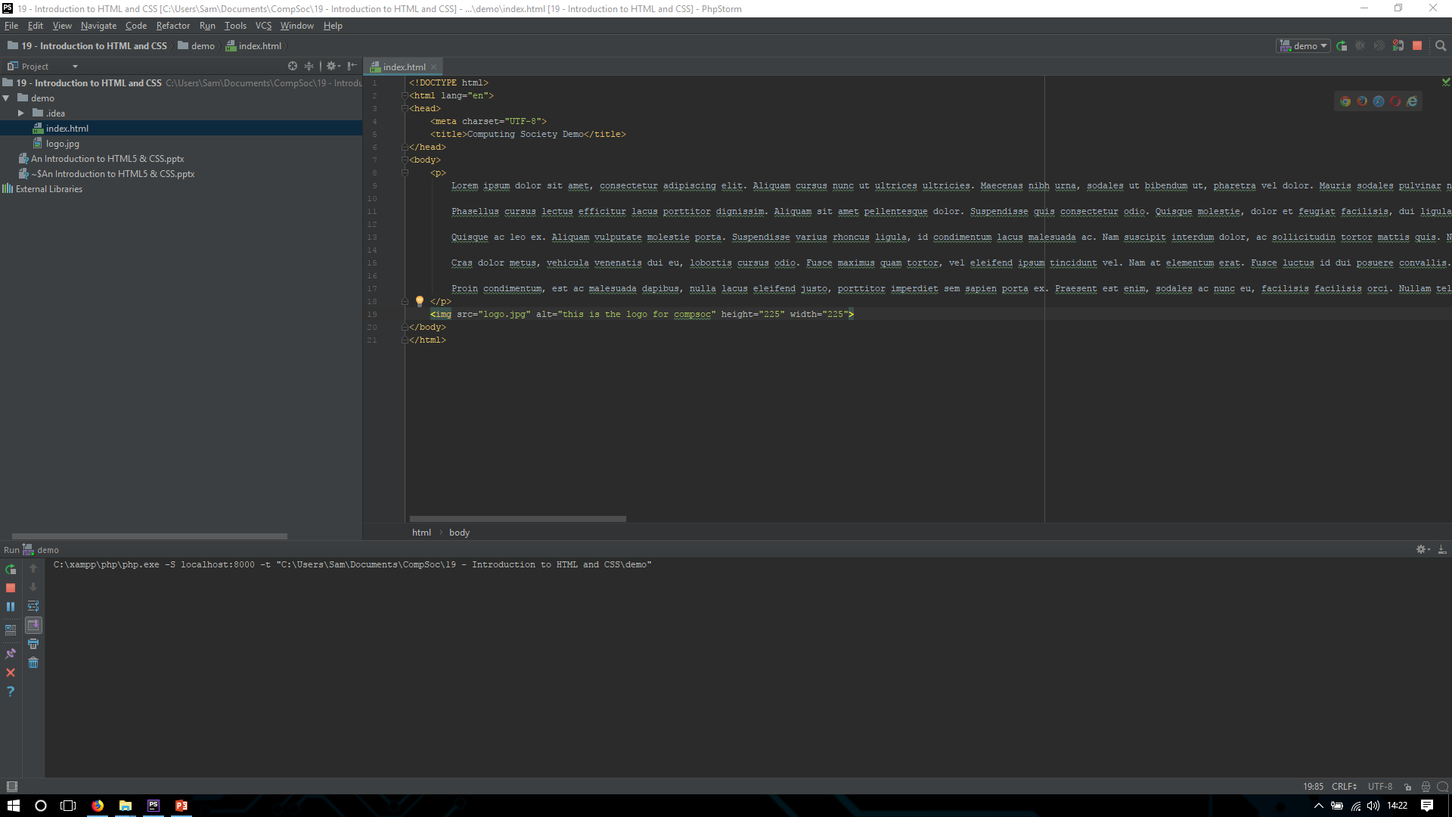
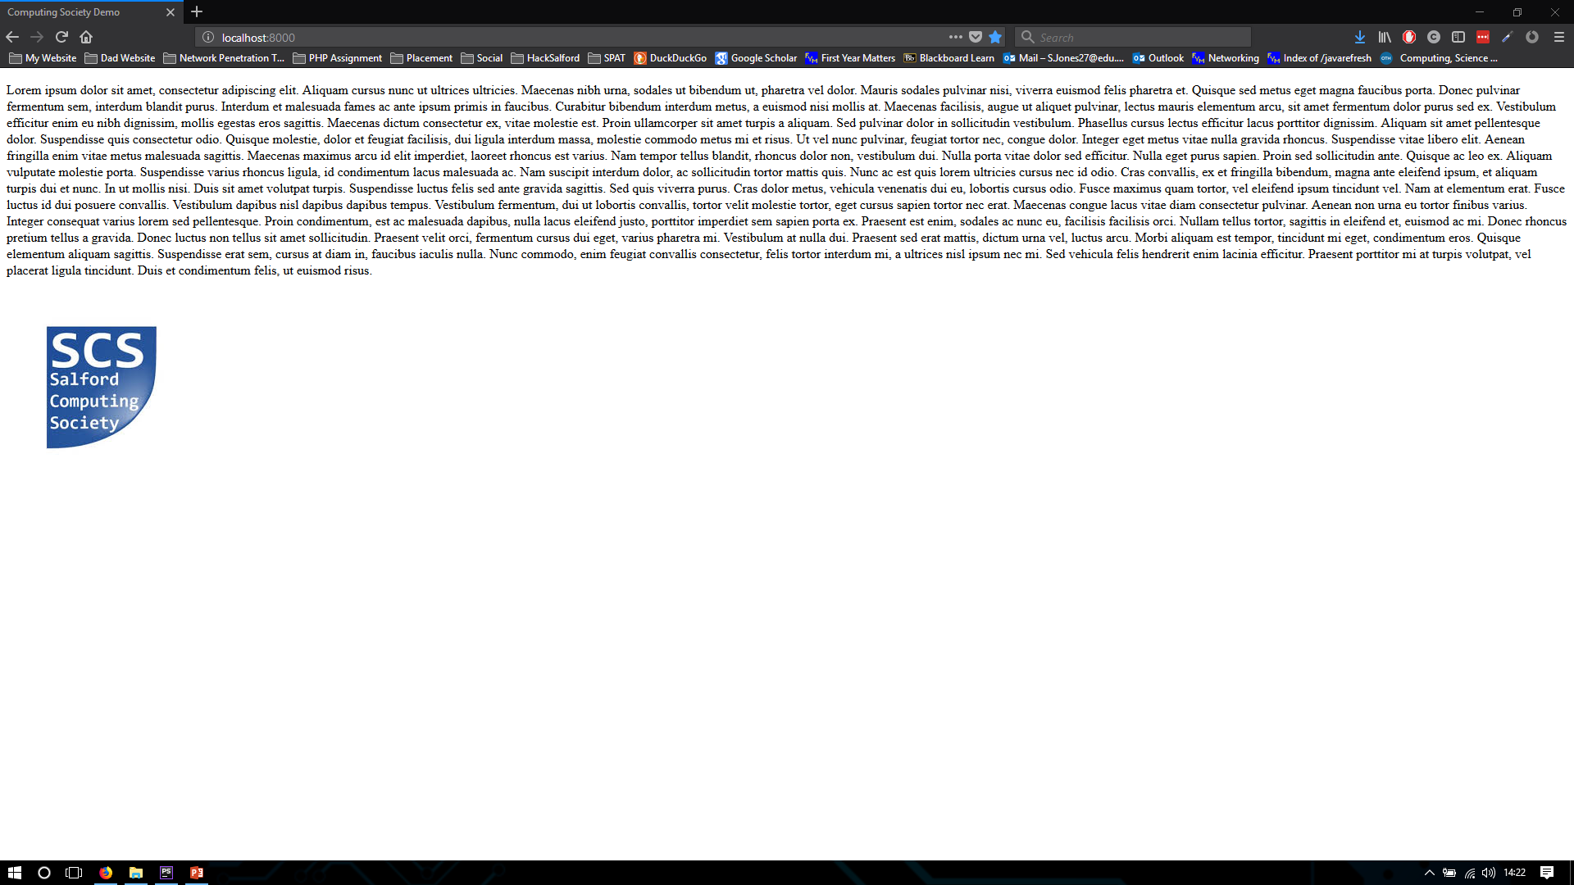
CODE
Site

Slide 18
Lets add some content
HOW ABOUT WE ADD A TITLE TO THE TOP OF THE DOCUMENT SO THE USER KNOWS WHAT THE SITE IS?
<h1> = this is very simple
IF YOU WANT MULTIPLE TITLES ON A PAGE THEN YOU NEED TO USE H2, H3, H4 AND SO ON!

Slide 19
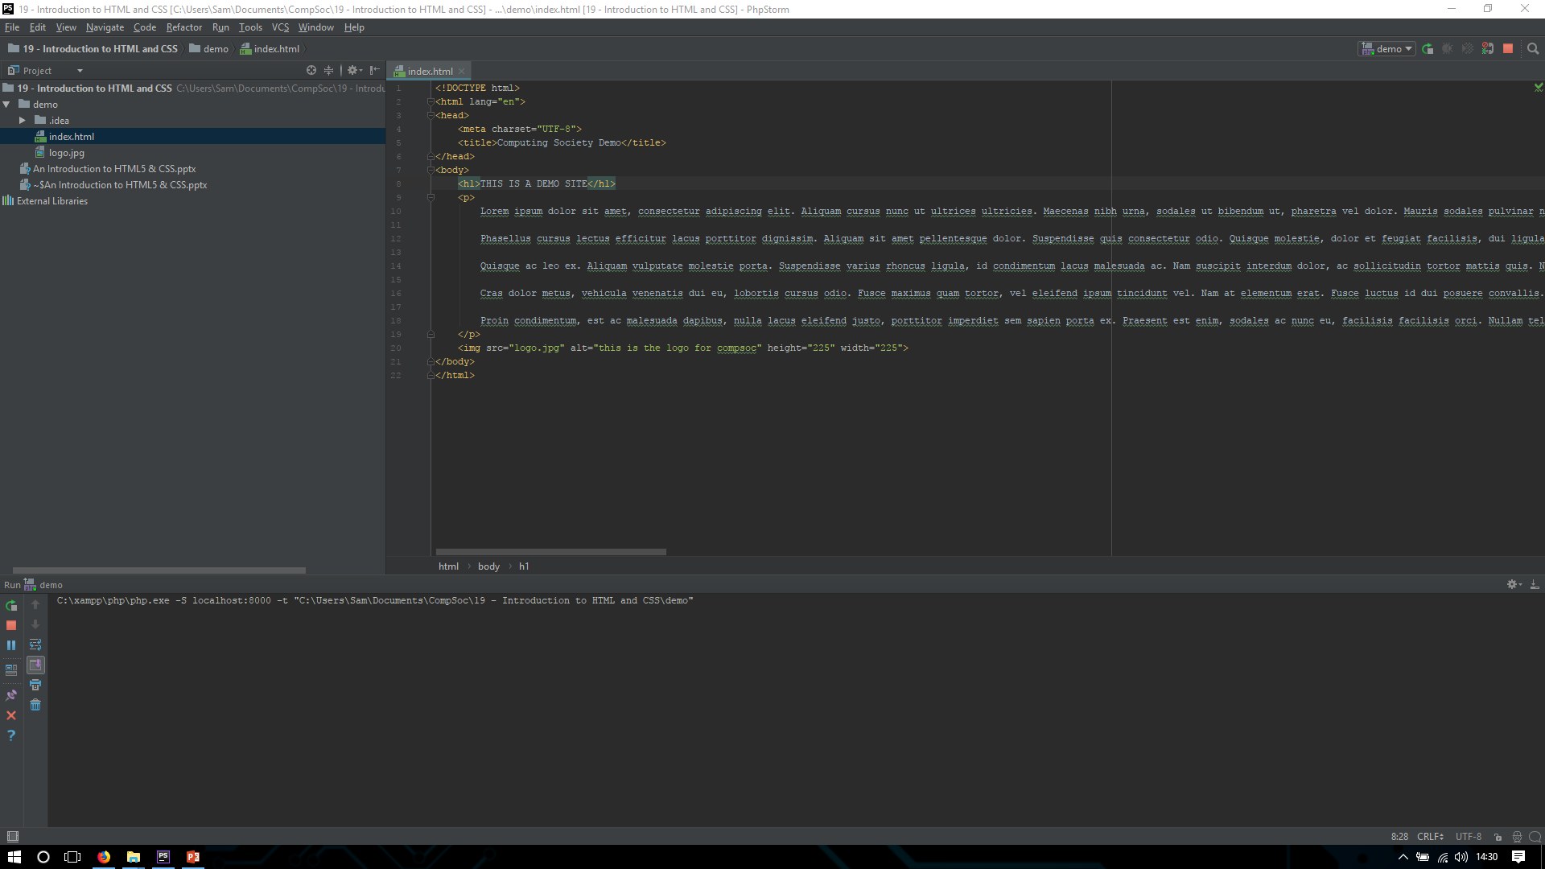
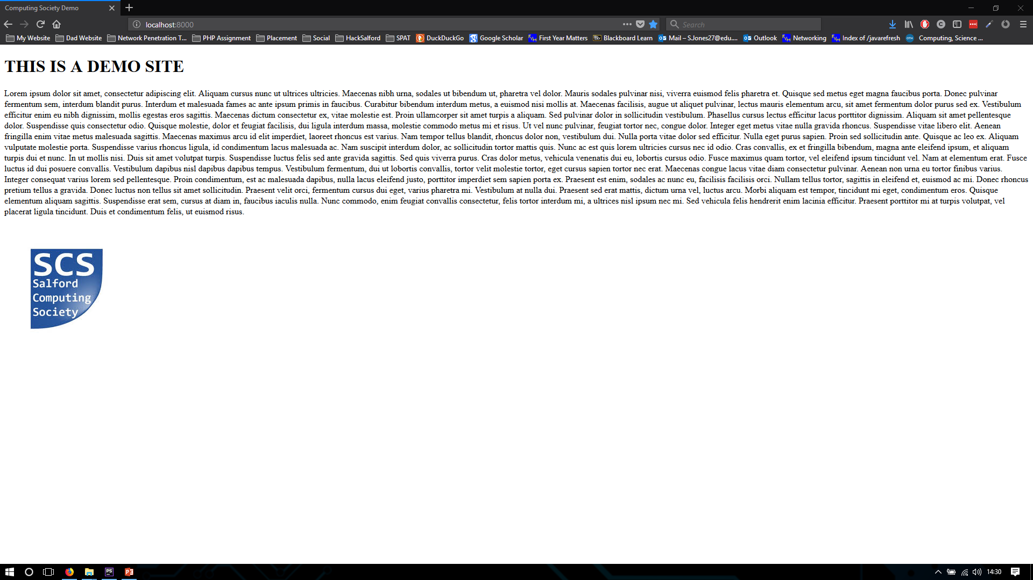
CODE
Site

Slide 20
Lets add some content
IT STILL NEEDS SOMETHING ELSE?
HOW ABOUT A TABLE. TO CREATE A TABLE WE USE THE TABLE TAG AS WELL AS THE TH, TR AND TD TAGS…
<table> = the defining element
<td> = is used to define cell data
<tr> = is used to define the row
<th> = is used to define the table column

Slide 21
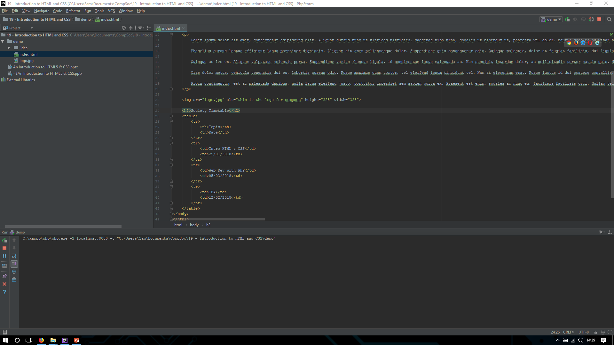
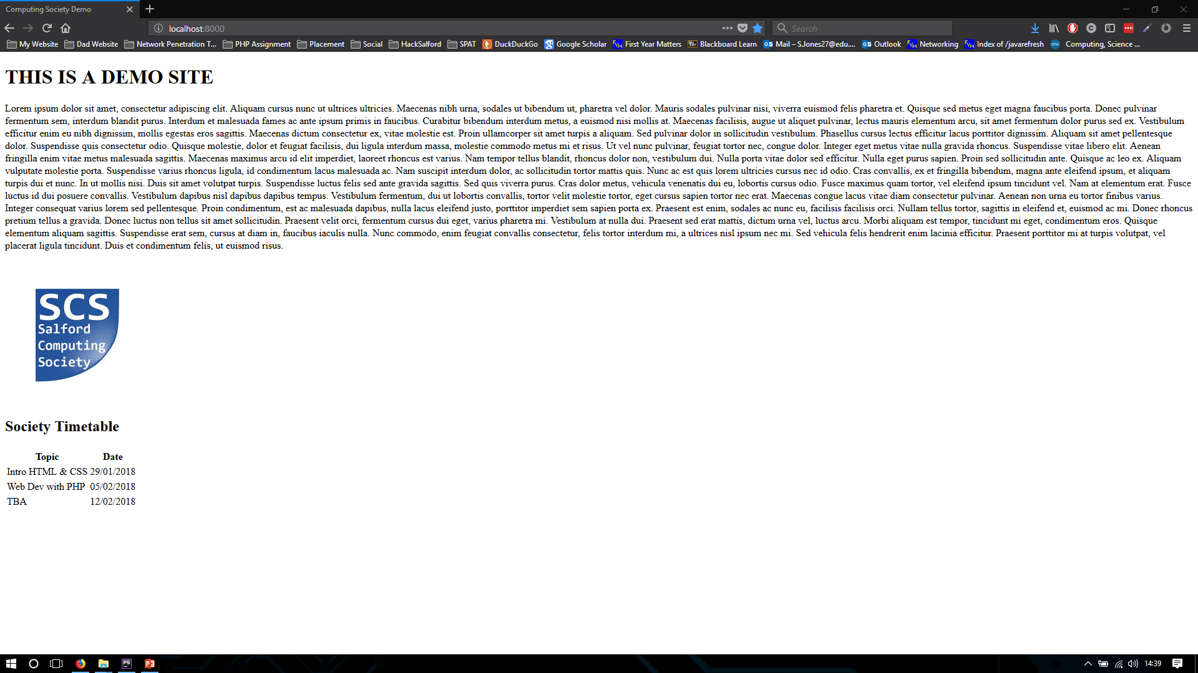
CODE
Site

Slide 22
Not very pretty is it?
So we now have a basic webpage. But it doesn’t look very nice does it? How about we introduce some CSS…

Slide 23
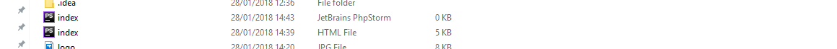
Not very pretty is it?
Lets create our css file…
We shall call it index.css – so it matches the page it is made for
We should now have…

Slide 24
Applying CSS to HTML
Before we can start making our site look nice we need to insert some new elements into the code…
We need to insert div elements into our code…
DIV is used to define a section or division in HTML code. This means we can divide our code into different sections and style each one to our choosing

Slide 25
APPLYING CSS TO HTML
I’m going to divide our page into four sections…
Title
Body
Image
TIMETABLE – THIS ENCASES the TABLE_HEAD AND TABLE CLASSES
TABLE_HEAD
Table
If you reload the page with the div tags in you will notice nothing has changed…
We must now apply a class attribute to our div tag…
<div class=“name”>
DO NOTE THAT YOU DO NOT NEED TO REFERENCE THE CLASS NAME IN THE CLOSING TAG FOR THE DIV!
WE NOW NEED TO REFERENCE OUR STYLE SHEET. IF YOU REMEMBER WE CAN DECLARE THE TAG LINK IN THE HEAD ELEMENT…
<link rel=“stylesheet” type=“text/css” href=“index.css”>
Rel= The relationship between the document and the link document
Type = The type of media
Href = The url or file directory

Slide 26
CREATING A CSS FILE
To reference a head name in css we use…
.NAME
{
STYLE
{
Lets start making the page look nice! How about we change the colour of the background a different colour. How about BLUE?
.Header
{
Background-color = RoyalBlue – Changed the colour of the div to royal blue(this can be a text input, RGB value or HEX CODE)
Text-align = center – moves the text to the middle of the page
font-family = changes the type of font
{

Slide 27
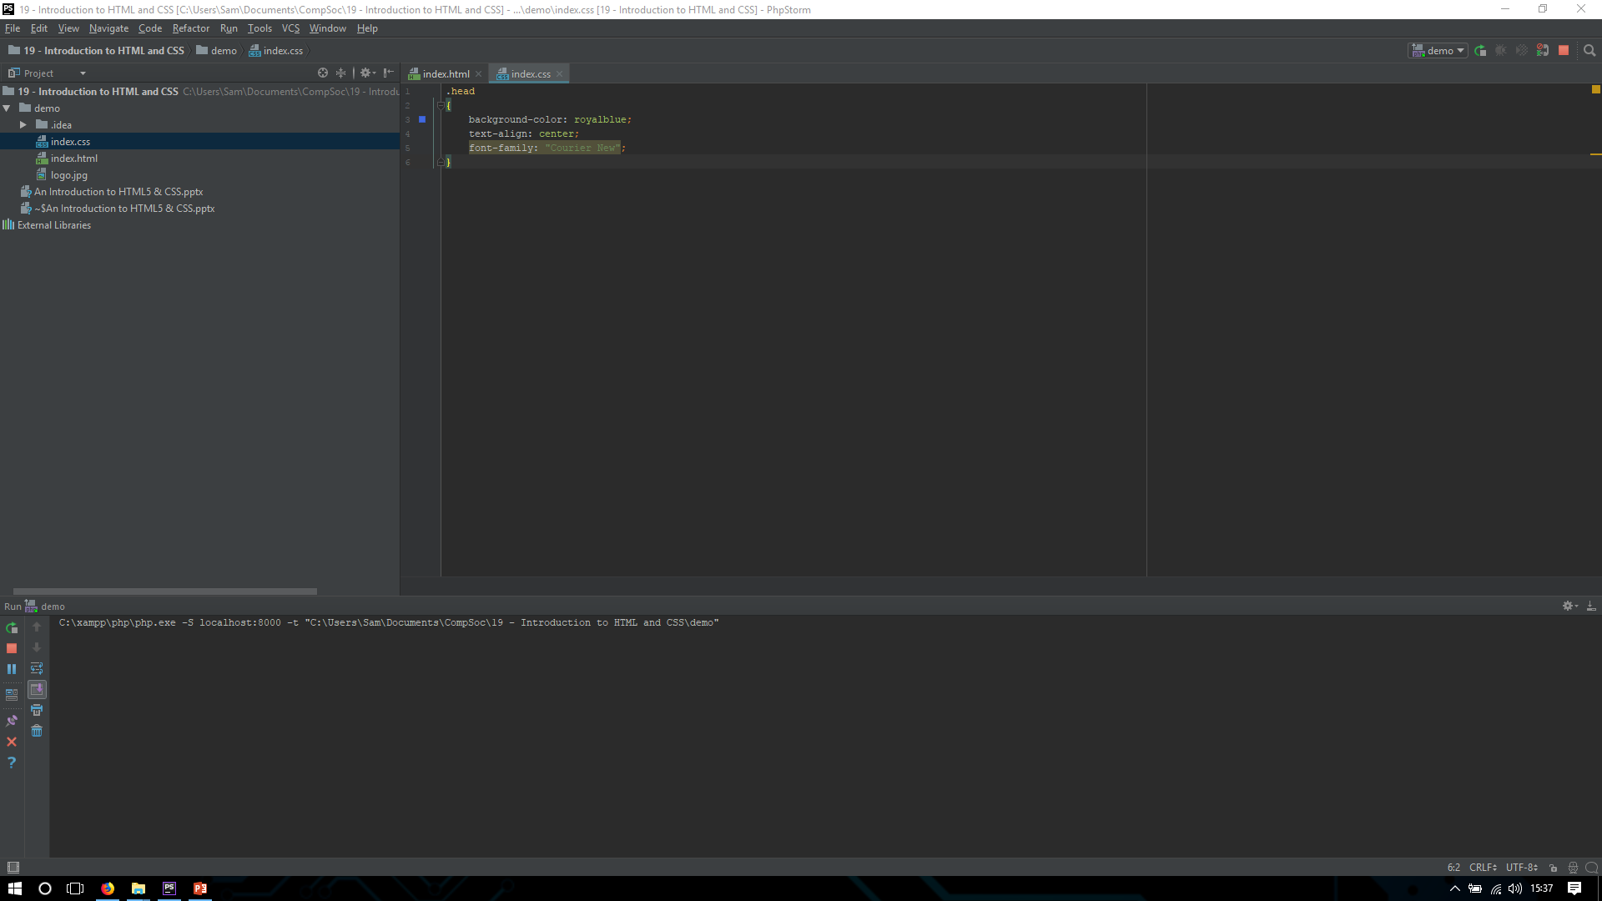
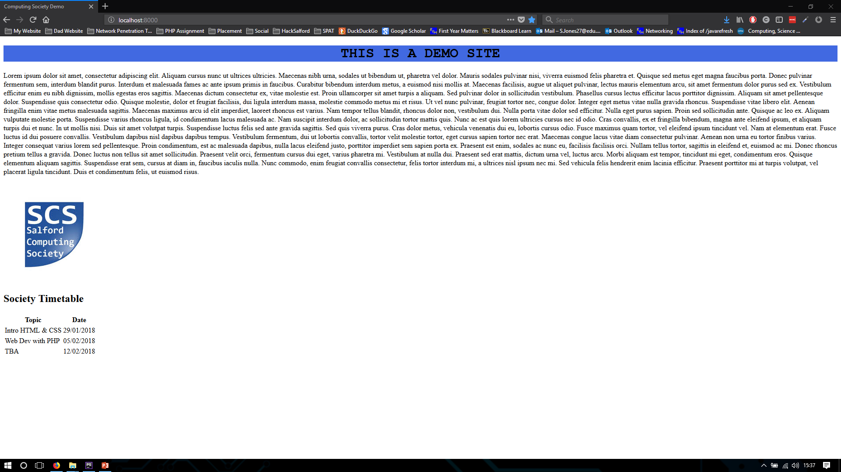
CODE
Site

Slide 28
CREATING A CSS FILE
How about we put a border around the text. It is very simple to do…
.text
{
border-style = solid
}
THIS PLACES A SOLID BLACK BORDER AROUND THE TEXT! HOW ABOUT WE TIGHTEN IT UP A BIT? EVERY TEXT FILED HAS A MARGIN AROUND IT, THIS CAN BE MANIPULATED TO PUSH TEXT AROUND THE PAGE.
.text
{
border-style = solid;
Margin-left = 10%; - Expands the left hand margin by 10% (Can be in pixels)
Margin-Right = 10%; - Expands the right hand margin by 10%
Background-color = lightgray;
Font-family = Verdanna;
}

Slide 29
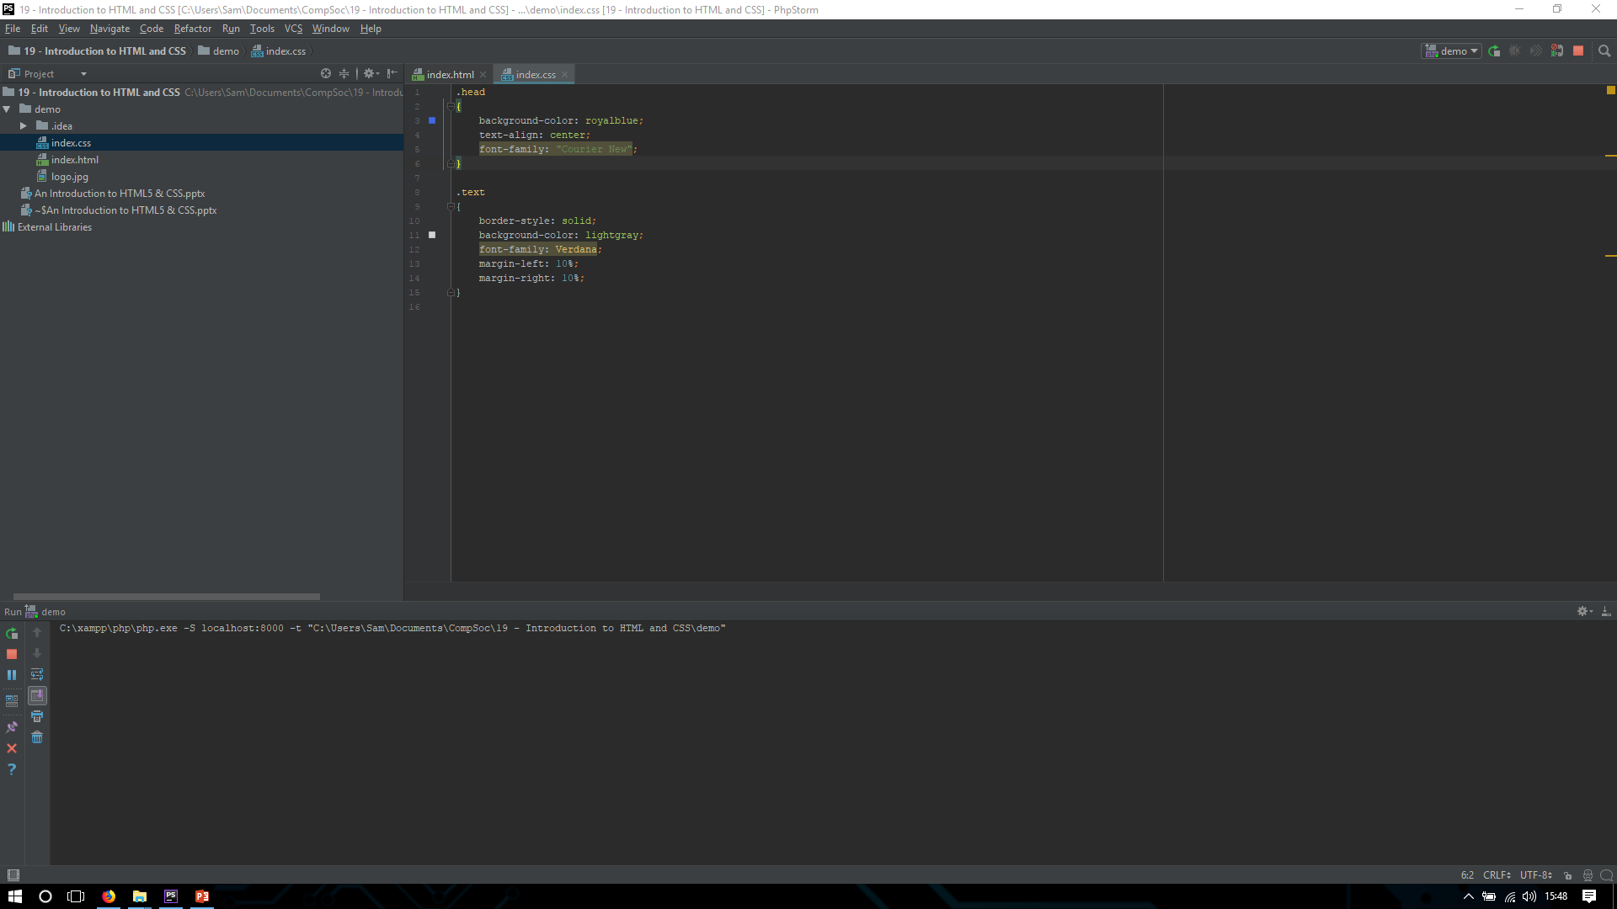
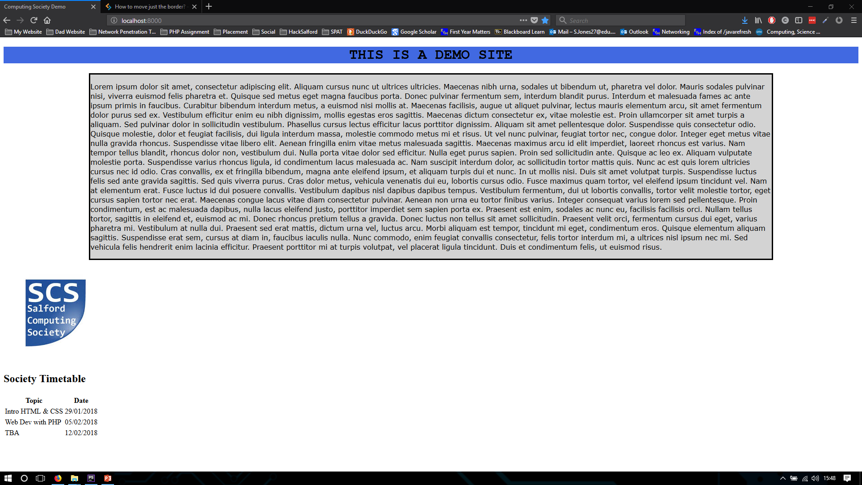
CODE
Site

Slide 30
CREATING A CSS FILE
Lets make the image and table appear next to the text…
We need to use the float, position and Margin properties.
Float = Allows you to take the element out of normal flow and position it to the far right or left of the page
Position = This can be static, Relative, absolute or fixed all effect how the page flows
We must also adjust the margins on the .text class…
.text
{
border-style = solid;
Margin-left = 20%;
Background-color = lightgray;
Font-family = Verdanna;
Float = right;
}

Slide 31
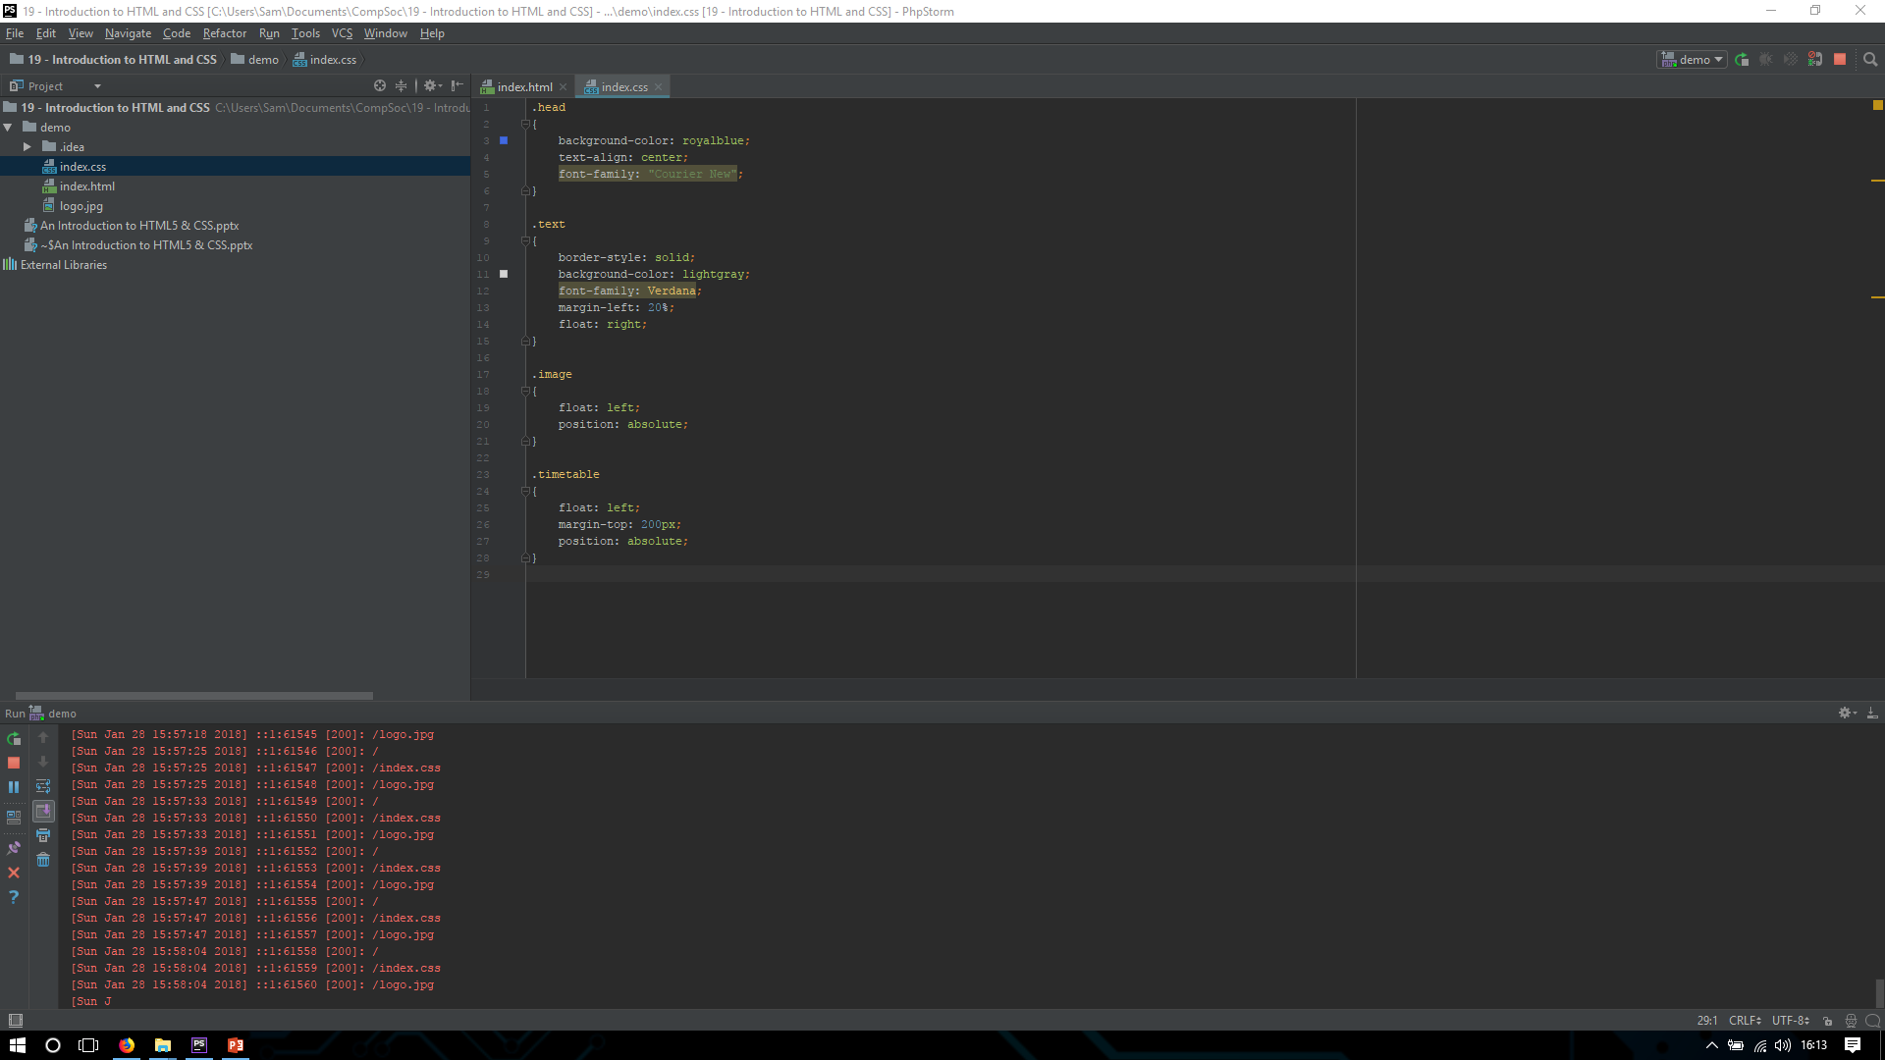
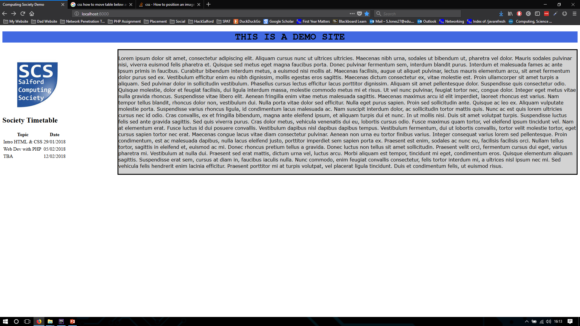
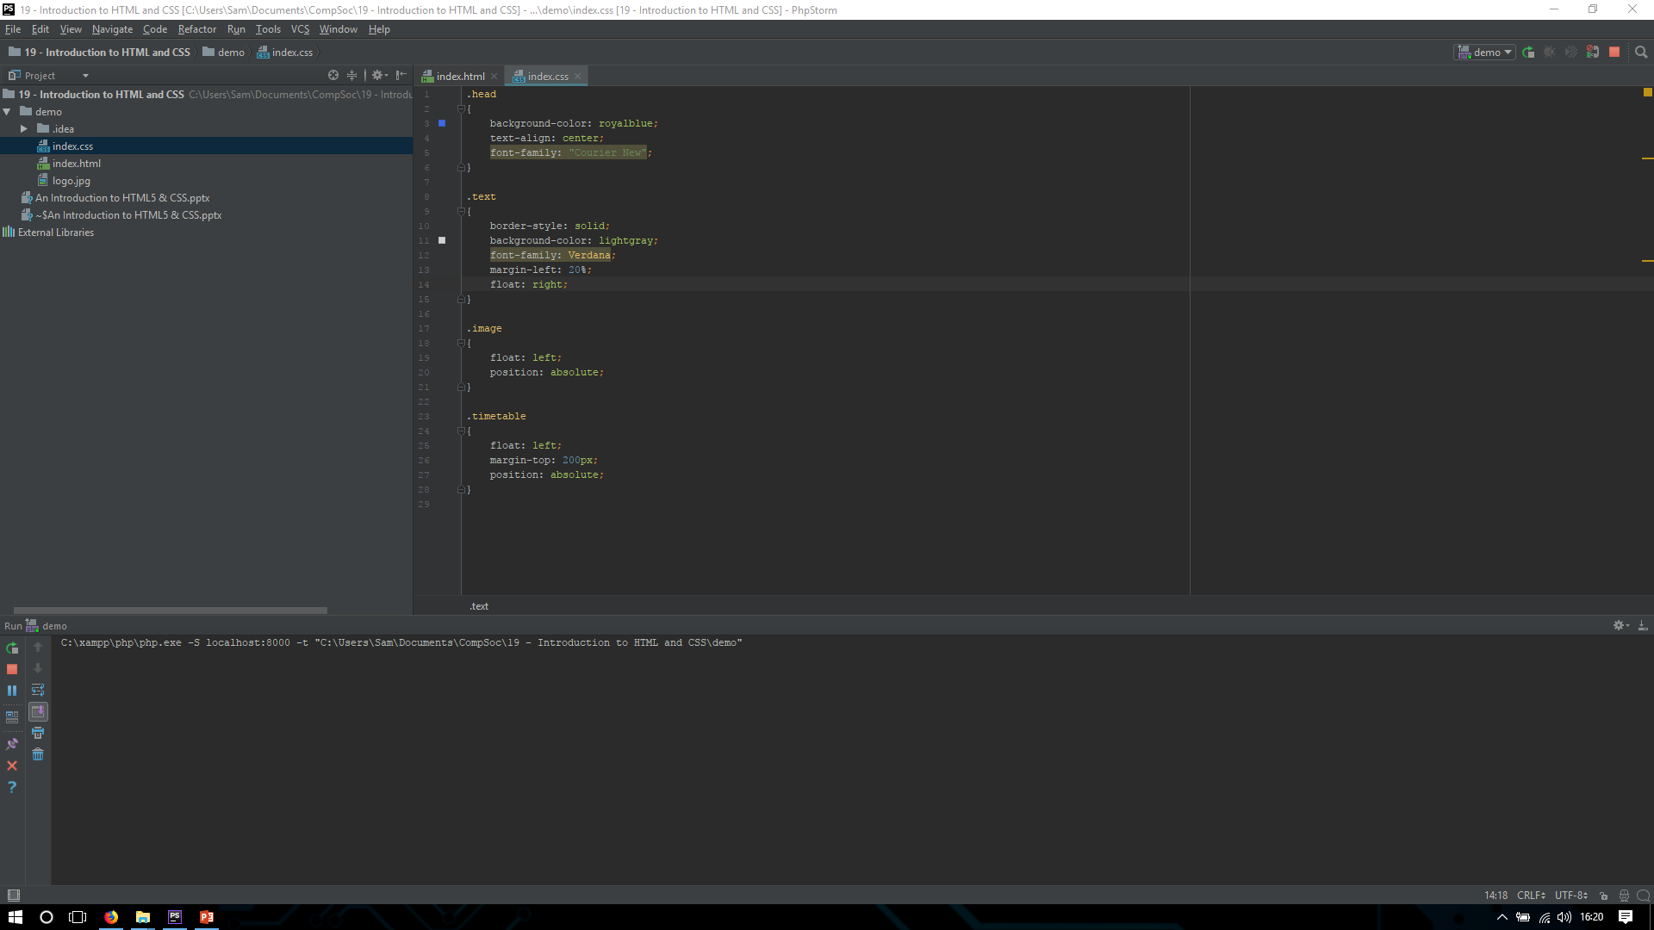
CODE
Site

Slide 32
CREATING A CSS FILE
Lets add a border around the table then we should be done!
One thing we can do with CSS is define an entire tag as one style. Instead of using a class I can assign all tr tags with one set css…

Slide 33
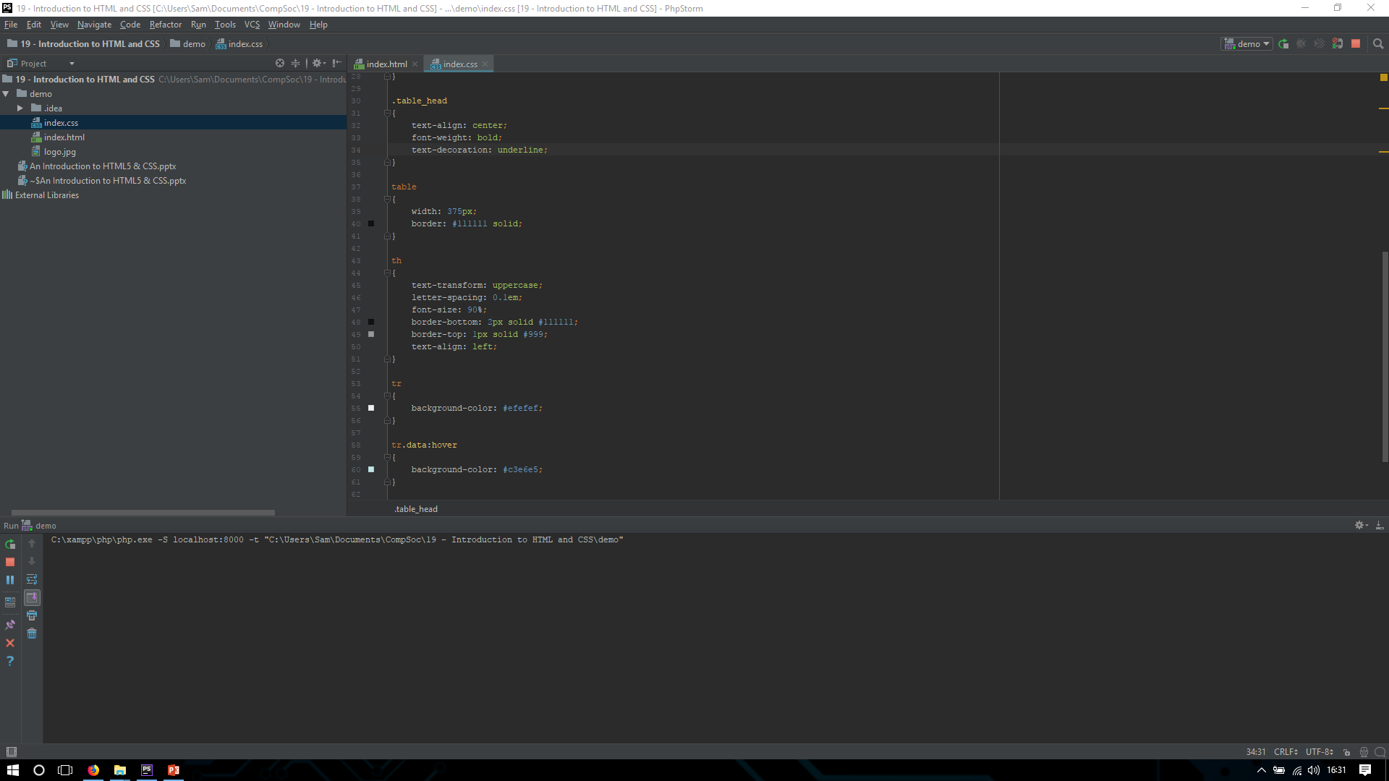
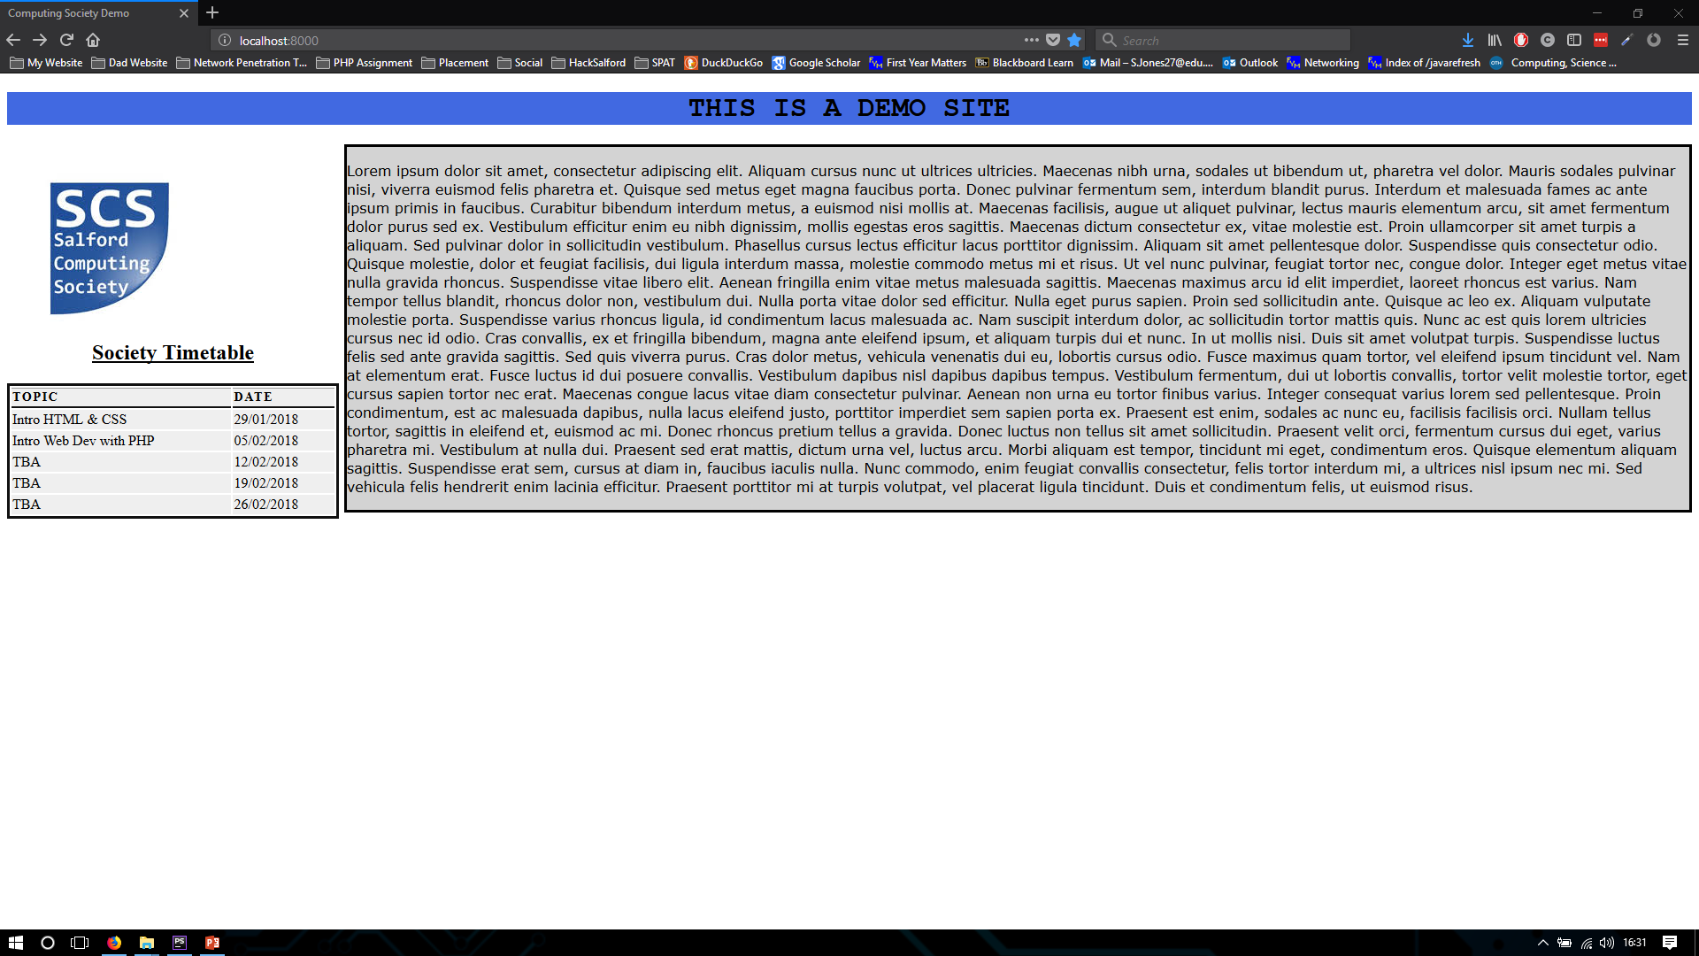
CODE
Site

Slide 34
AND THAT’S THAT
We now have a very basic landing page for our user to arrive at!
See if you can add more features or explore the css library and try and use different styles!

Slide 35

Things to come
Next week we will be creating a survey form and be focusing sending data between two pages using PHP!

Slide 36



Final Notes
This slide and the code used can be found on my GitHub. Feel free to download it.
Github - https://github.com/SamJones01
Twitter - https://twitter.com/uoscompsoc
Students Union - https://www.salfordstudents.com/groups/computing

